Slide 1

CubeSat Mounting Fixture Critical Design Report
April 24, 2020
Northern Arizona Senior Design Team:
Richard Campos – Project Manager
Jacqueline Fonseca – Website Designer
Zackary Retzlaff – Client Contact
Jacob Belin – Budget Liaison
Notes:
1

Slide 2
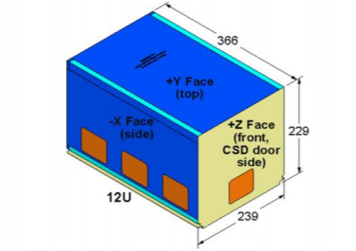
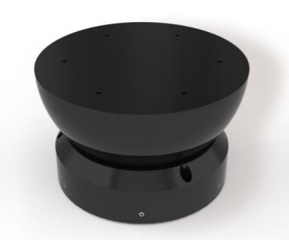
Program Description
The proposed effort will design a mounting fixture for a 12U CubeSat so a frictionless environment can be achieved on an Air Bearing Test Stand.
The design must:
Refocus Center of Gravity*
Limit Tilt Degree
Be Adjustable in Three Axes*
Be Adjustable to Different Payloads

Slide 3
Design Requirements Engineering Requirements
Table 1: ER and their target values
ER | Target Value | Tolerance | How it is met
Accept CubeSat (Lifts Weight) | 24 kg | 2 kg | Material properties/clamping device
Movability in all Axis | 50 mm | 2.5 mm | Sliding plate
Limit Tilt Degree | 35 deg | 1.75 deg | Fixture can only tilt 35 degrees in each direction
Allow 360 Deg Rotation | 360 deg | - | Moves with the air bearing
Limit Weight | 50 kg | 2.5 kg | Weight of the fixture is much less than that since light materials are being used
Limit Size | 9 m^3 | .045 m^3 | Total size of the fixture does not exceed this amount
Material Strength | 200 MPa | 10 MPa | Materials
Lifetime Cycle | 1*10^4 | N/A | Materials/Durability of parts
Notes:
List your project’s Engr Requirements with targets and tolerances and indicate how your design meets them.
Provide visual means to prove how the ERs have been met with the design.

Slide 4
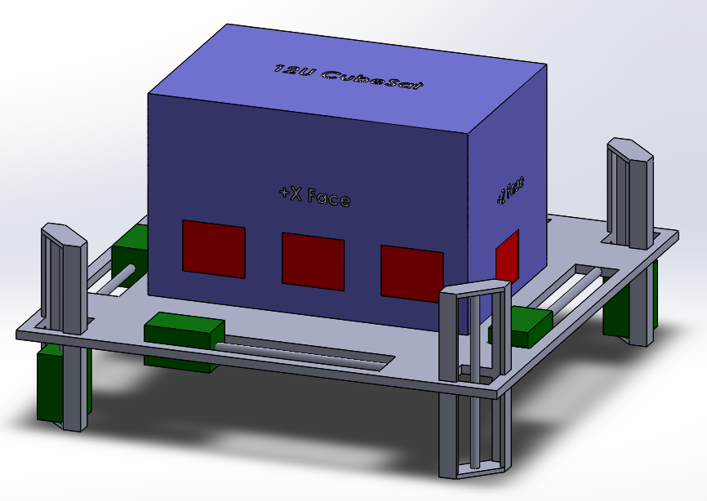

Design Description CAD Model Assembly
Mounting fixture with counterweights and rails (as seen with 12U CubeSat model)
Notes:
Describe the current state of your design and CAD model

Slide 5
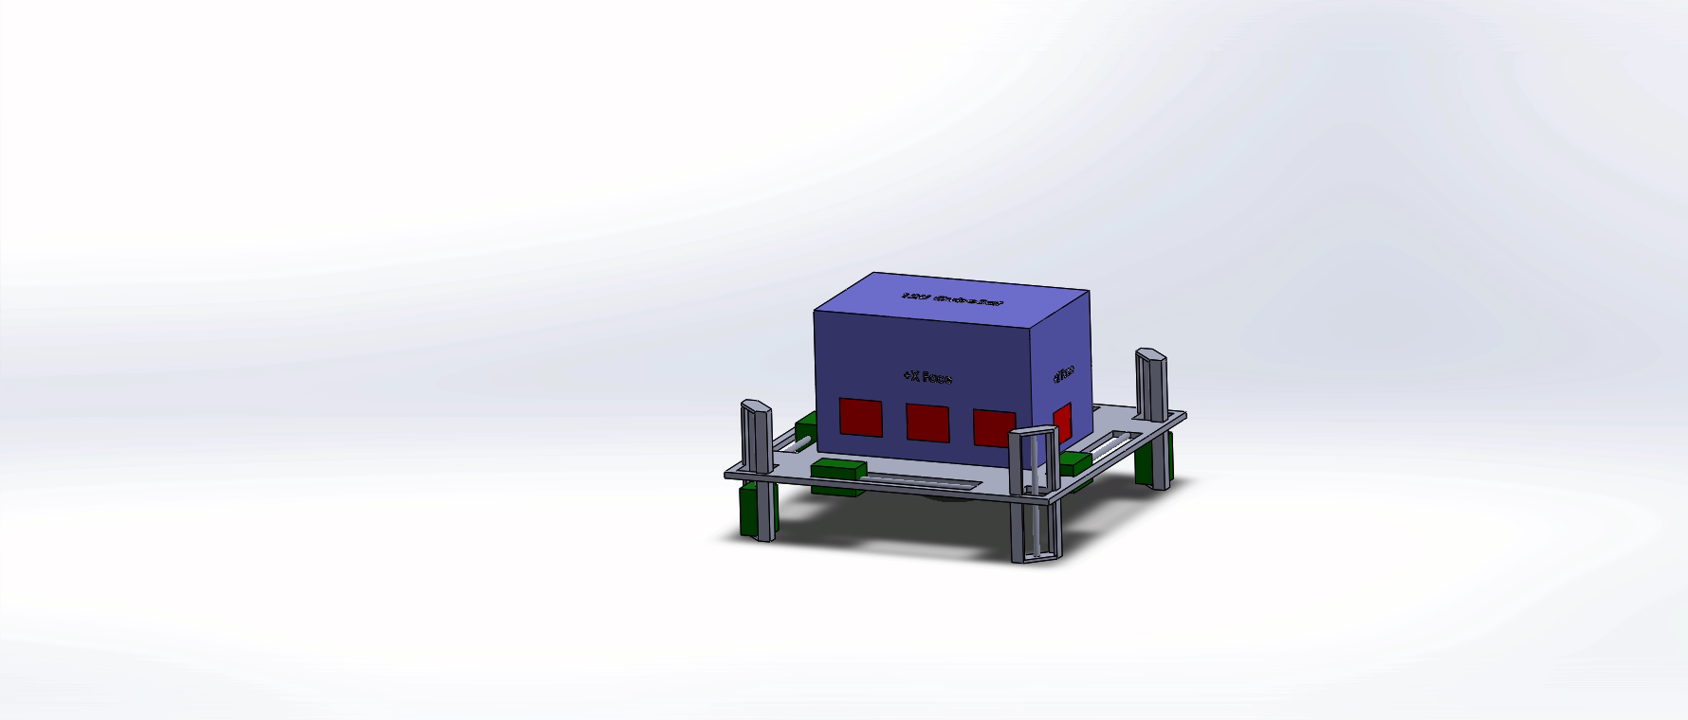
Design Description Exploded View

Slide 6
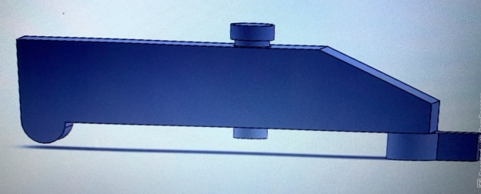
Design Description Clamping System
Dimensions provided by Planetary Systems Corporation
Will secure mounting fixture to CubeSat
Repurpose CSD tabs to secure CubeSat to mounting fixture

Slide 7
Design Description Functionality
The clamps securely attach the CubeSat to the fixture
These clamps are adjustable on the fixture to accept different payloads
They are on a sliding device that locks
The bottom of the fixture is tapped to secure the fixture to the air bearing semi-sphere. (slide 2)
The Arduino and Pressure Sensors locate the center of gravity and communicate adjustments to motors
Pneumatic Torque Motor displace counter-weights on a power screw to refocus center of gravity
4 Wt/Screw for X- and Z-axis
2 Wt/Screw for Y-Axis (potential)
The fixture design does not obstruct keep out zones
Red areas on slide 3
Notes:
Provide a bullet list describing how your design functions or the implementation details
Six Locations has to be changed to match what was done on the CAD Model

Slide 8

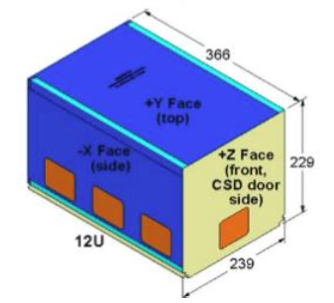
Analytical Analyses: Center of Gravity
Must calculate center of mass in all three directions
Focused on CG of 12U but can also manipulate for 3U and 6U
Maximum center of mass in each direction were given by General Atomics
Notes:
• Provide computational proof that the CRs and ERs have been satisfied. Discuss analytical analyses that have been conducted to prove the design will be successful

Slide 9
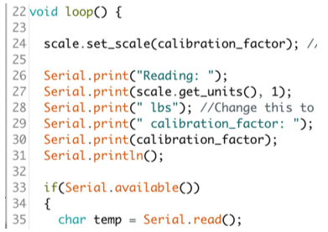
Analytical Analyses: Center of Gravity
Created Arduino Code to take reading from force sensors
Force sensors read pressure distribution from CubeSat weight in each direction
Accountable for different payloads
Notes:
• Provide computational proof that the CRs and ERs have been satisfied. Discuss analytical analyses that have been conducted to prove the design will be successful

Slide 10
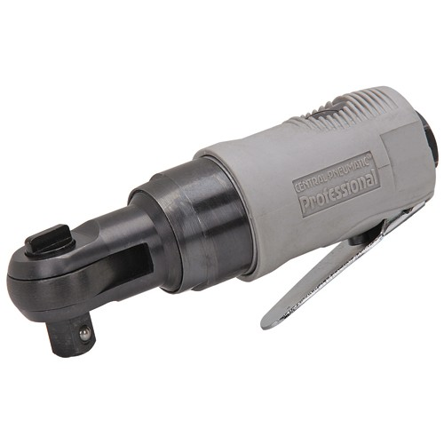
Analytical Analyses: Pneumatic Motors
Analysis of magnetic fields associated with stepper motors determined that they could not be used
1.6 µT limit exceded 1 nT limit
Pneumatic motors are now used in actuator
Current plan is to modify existing pneumatic tools to fit with our design and drive lead screw mechanism
- Current option for pneumatic motor
Notes:
• Provide computational proof that the CRs and ERs have been satisfied. Discuss analytical analyses that have been conducted to prove the design will be successful

Slide 11

Analytical Analyses: Tank
Table 2: Tank options information
Conclusion
One filled CO2 Tank allows for six times more cycles than the Air Compressor Tank
However, the Air Compressor Tank is readily available to the clients and eaisly fillable
The Air Compressor will be used externally for our device
Notes:
• Provide computational proof that the CRs and ERs have been satisfied. Discuss analytical analyses that have been conducted to prove the design will be successful

Slide 12
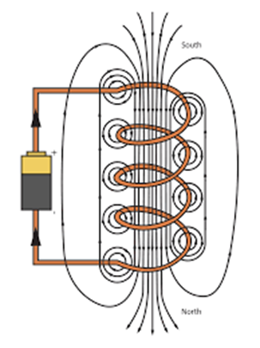
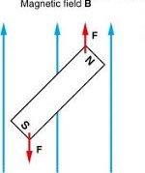
Analytical Analyses Magnetic Flux from Valves
Solenoid Valve is an induced magnet to toggle flow (variable or WOT)
Notes:
• Provide computational proof that the CRs and ERs have been satisfied. Discuss analytical analyses that have been conducted to prove the design will be successful

Slide 13
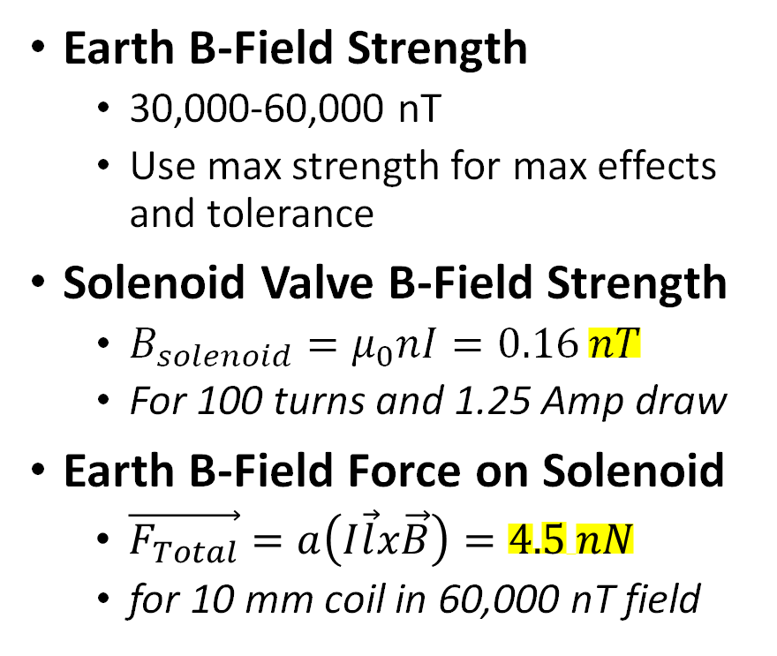
Analytical Analyses Magnetic Flux from Valves
Earth B-Field Strength
30,000-60,000 nT
Use max strength for max effects and tolerance
Solenoid Valve B-Field Strength
$B_{solenoid}=μ_{0}nI=0.16 nT$
For 100 turns and 1.25 Amp draw
Earth B-Field Force on Solenoid
$\vec{F_{Total}}=a\left(I\vec{l}x\vec{B}\right)=4.5 nN$
for 10 mm coil in 60,000 nT field
Conclusion
CubeSat does not distinguish solenoid field vs Earth field
Force from solenoids in B-field is 0.02% drag force from air bearing
Due to sensitivity of internal CubeSat instruments, normally closed valves will be used to regulate flow for pneumatic motors
Notes:
• Provide computational proof that the CRs and ERs have been satisfied. Discuss analytical analyses that have been conducted to prove the design will be successful

Slide 14
Design Validation: Risk Analysis
FMEA (Failure Mode and Effects Analysis)
Thorough analysis of worst-case scenario damage
Development of repair/replacement procedure for damaged parts
Integrate ease of assembly/repair into design
Preventive maintainance procedures to be developed to minimize part failure and damage
Subsystem Failures
Detailed FMEA will prepare the team to make pre-emptive alterations to subsystems in order to reduce time of redesign and manufacture of necessary parts
Notes:
Discuss your team’s risk analysis, including critical potential failures and how your design mitigated these. Discuss the risk trade-off analysis that your team has performed.

Slide 15
Design Validation: Testing Procedure
Plan is to test each sub-system first
Pneumatic System: Powers Motion
Pneumatic system would be set up, with a compressor connected to a valve connected to the motors
Then the system will be turned on to assure the motors work
After assuring the motors run the motors will be connected to the power screws/counter-weights
The test will also calculate the amount of pressure needed to run
Counter-Weights on a Power Screw: Relocating CG
The fixture will be set at different angles and the counter-weights will be moved to balance the fixture
The counter-weight locations will be checked by hand calculations
Notes:
Provide an overview of the Testing Procedures that you will complete in the second semester to prove the ERs have been met (these are the physical tests that will be performed on the system). • List all equipment, resources, space, etc. needed to complete the Testing Procedures.

Slide 16
Design Validation: Testing Procedure
Clamping Mechanism: Secure CubeSat
The clamps and CubeSat tabs will be made by 3D printing
Then the tabs will be attached to a cube that weighs the same as a 12U CubeSat
Then the clamps will attach and will assure stability by moving the device in different angles
Arduino and Pressure Sensors
A certain amount of weight will be placed on the pressure sensors at different weights
Using calculations we will check the pressure sensors are accurate
Then we will attach the Arduino to the pneumatic system to test the ability to be turned on and moving the counter-weights

Slide 17
Design Validation: Testing Procedure
Entire System
Connect all subsystems into the final fixture
Place a weight the same size as a 12U CubeSat
Set the Fixture at a specific angle and turn the system on
Check the locations of CG using hand calculations

Slide 18
Design Validation: Testing Procedure
Table 4: Testing Equipment Needed
Sub-System Testing | Equipment Needed
Pneumatic System | Compressor / Air Tank Valve Air Tubing Pneumatic Torque Motor
Counter-Weights / Power Screws | Power Screw Count-Weights Flat Plate "Fixture" Cube Weighing same as 12U
Clamping Mechanism | Clamps CubeSat tabs Flat Plate Fixture Cube weighing same as 12U
Arduino / Pressure Sensors | Arduino Pressure Sensors Cube weighing same as 12U
Entire System | Same as all other tests

Slide 19
Budget Bill of Materials for Prototype
Part # | Part Name | Qty | Description | Functions | Material | Dimensions | Cost ($USD)
1 | Pnuematic Tool | 6 | Reverse engineered pnuematic wrench | Displace counter wt | Aluminum | - | 179.94
2 | Tubing | 1 | Piping for working air to pnuematic motor | Direct air to motors | Aluminum | 0.5"x48"x1/16" | 12.98
3 | Compressor | 1 | Pnuematic system | Provide air supply for pnuematic system | - |  | 0
4 | Pipe Fittings | 10 | Pnuematic system | Direct and couple air lines for motors | Brass | 0.5" | 40
5 | Storage Tank | 1 | Pnuematic system | Hold air supply for pnuematic system | Steel | 8"x10"x1/8" | 0
6 | Ctr. Wt. and Bench for Motors | 8' | Stock material for prototyping | Stock material for prototyping | Wood | 1"x4" | 22.45
7 | Fasterners | 1 | Securing components | Securing components | Plastic |  | 6
8 | Fasterners | 6 | Securing components | Securing components | Aluminum |  | 2.76
9 | Pressure Sensors | 4 | Force sensing resistor | Determine CG location | - |  | 44.36
10 | Lubricant | 1 | Petrol based lube | lubricate pnuematic motors |  |  | 4.95
11 | Platform | 5 | Stock sheet metal for fab work | Attach CubeSat to air bearing stand | Aluminum | 6"x18" | 20.1
12 | 3D Material | 4 | Corn based plastic | for 3D printed model | Corn/Plastic |  | 79.4
13 | 12V Batter | 1 | Simple RC battery | Provide energy for Arduino system & valves | Lithium |  | 6.2
Total Cost Estimate ($USD): 419.14
Expenses to Date ($USD): 29.99
Notes:
Describe the project’s budget including total dollars available, anticipated expenses, actual expenses to date, and the resulting balance.

Slide 20
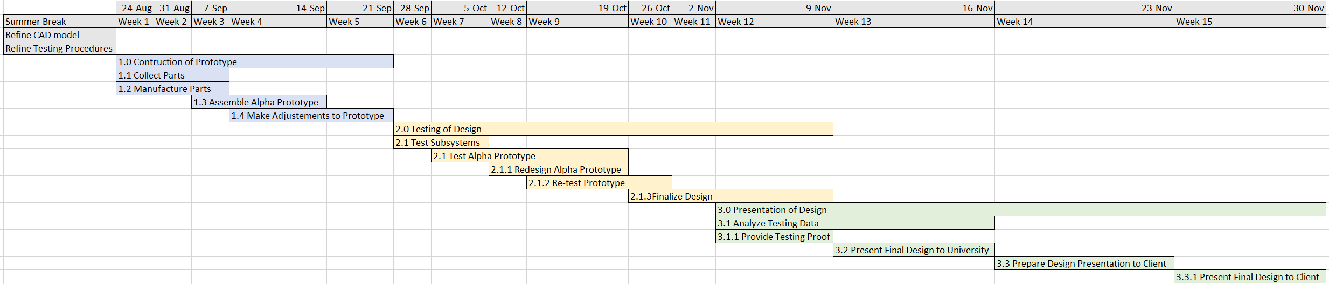
Schedule
* Schedule is subject to change depending on design failures and COVID-19 crisis
Notes:
Provide a schedule for the next term showing when key tasks will be completed. Indicate if you are currently on, ahead, or behind schedule. Discuss how the team broke down the work for each person.

Slide 21
Looking Ahead
For the Summer
Continue inter-team and client communication
Develop and refine CAD models
Prepare testing of prototype
For Fall Semester
Purchase/manufacture parts
Assemble and test prototype
Present final design

